Slide 1
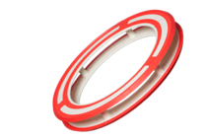
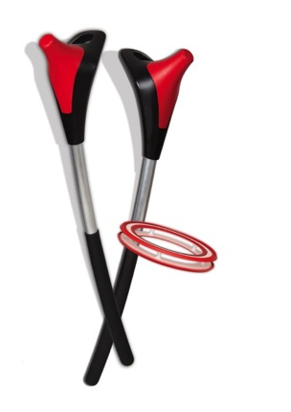
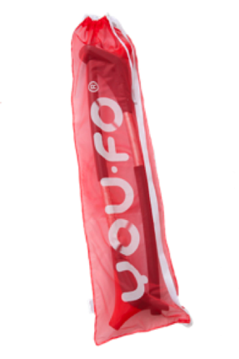
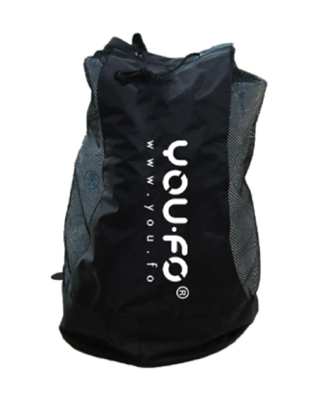
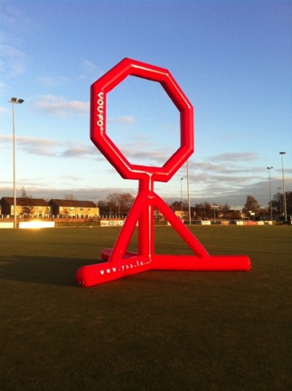
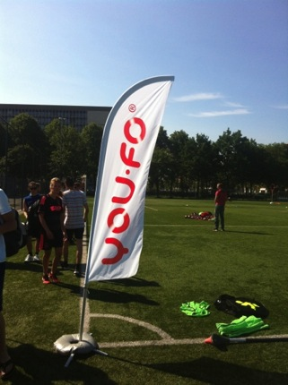
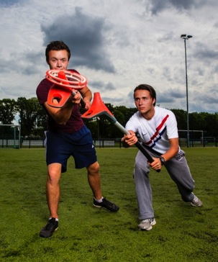
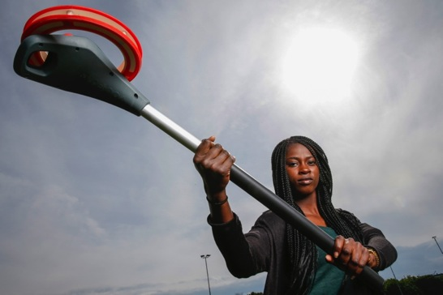
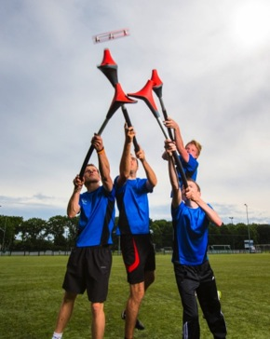
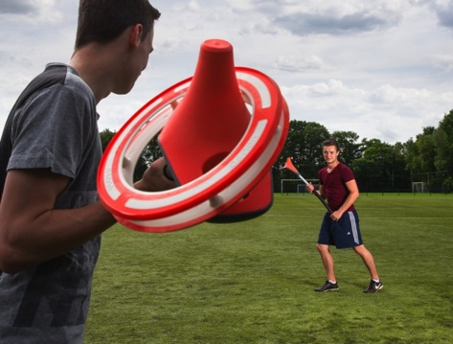
What is YOU.FO?
Bas .. Wat extra beeld materiaal opnemen
Filmpje
Link naar you tube videos
Etc..
https://vimeo.com/128118542
Notes:
Muziek zacht.
Zie slides A1 en A2
PRODUCT / DOELGROEP
Innovatief sportspel ring/stick
Basis werpen en vangen over afst 10-30mtr.
Huidige vorm 10+
Veelzijdig concept:
1-op1
Met goals
Teamverband of leisure.
Beantwoord aan behoefte om samen schaare tijd door te bvrengen op een gezonden vernieuwende en leuke manier.
Vrijetijdsfactor frisbee / sport factor van hockye en lacrosse.
Dynamisch / variatie / verslavend/ Leercurve.
Easy to play hard to master.
PRIJS
Kostprijs=€20 > €15.
Retailprijs 99 set
Tussenhandel > €50.
(30-60 marge).
Uiteindelijk willen we zakken tot retailprijs €50 voor instapversie

Slide 2
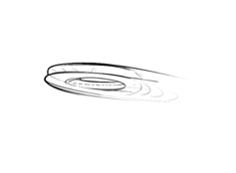
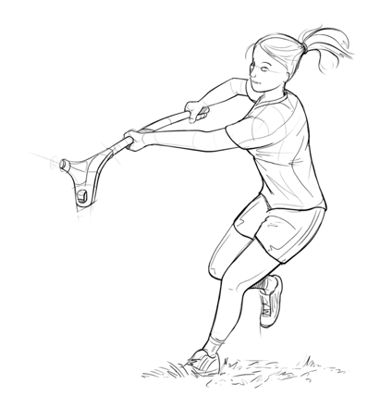
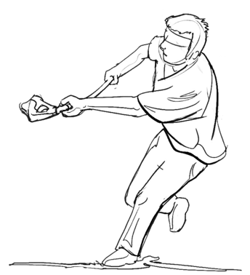


What is YOU.FO?
New, Unique, Fun & Healthy
SPORTS Game + Game Concepts

Slide 3
Kas ir YOU.FO?
Jauna, unikāla, jautra un veselīga
SPORTA spēle + dažādi spēles varianti

Slide 4
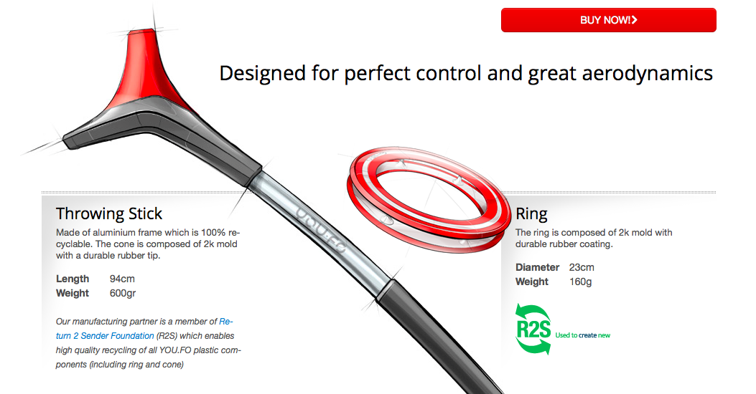
The Product

Slide 5
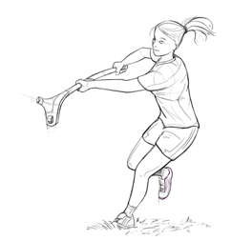

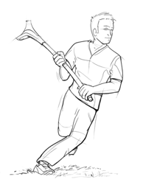
Game concepts
YOU.FO requires concentration, strength, flexibility and cooperation.
YOU.FO can be played one-on-one or in teams, with goals or freestyle, in city parks, on sports fields or at the beach.
Age: 10+.

Slide 6
Spēles doma un varianti
YOU.FO attīsta koncentrēšanos, spēku, elastīgumu, sadarbību.
YOU.FO var spēlēt viens pret vienu vai komandās, uz rezultātu vai vienkārši brīvajā laikā, pilsētas parkos, sporta laukumos vai pludmalē.
Vecums: 10+

Slide 7
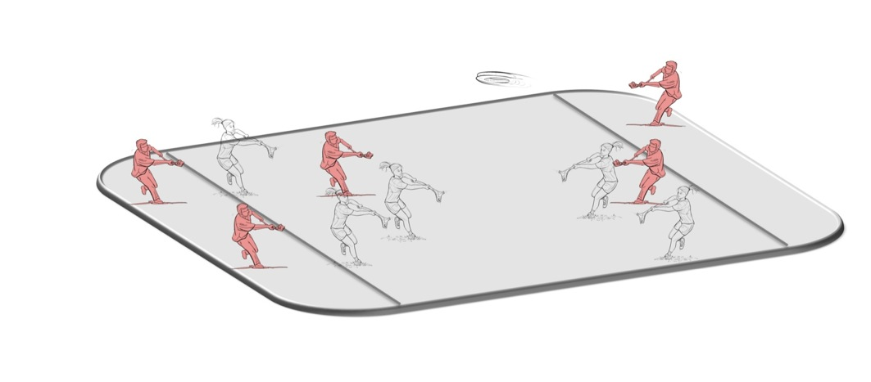
YOU.FO 5x5 official team competition game
You score points by catching the ring in the endzone behind the opponent’s part of the playing field. Outdoor minimum field size: 25 x 50 meters.

Slide 8

YOU.FO 5x5
Komandu spēle
Gūsti punktus noķerot riņķi pretinieku komandas beiguzonā, kas ir laukuma daļa aiz pretinieku komandas.
Minimālie laukuma izmēri spēlējot ārā: 25 x 50 metri.

Slide 9
YOU.FO competition game
Innovative, Fast and dynamic
Non contact
  Safety rules (personal zone)
Mixed boys & girls
Beach / (artificial) grass
10+

Slide 10
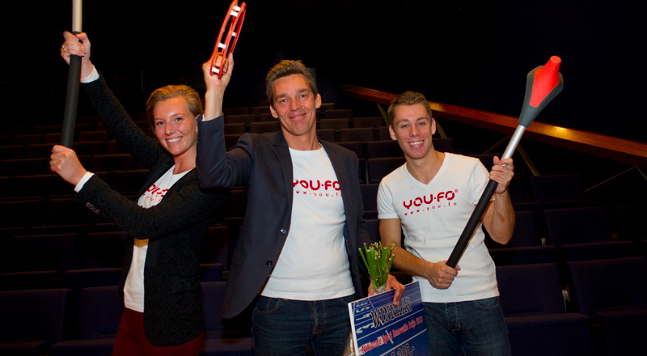



Our achievements
Winner Dutch National Sport Innovation Award 2013
Finalist ISPO Brand New award 2013
Winner European Profit Award fieldlab Eindhoven
Official demonstrative Sport at the CSIT World Sport Games

Slide 11
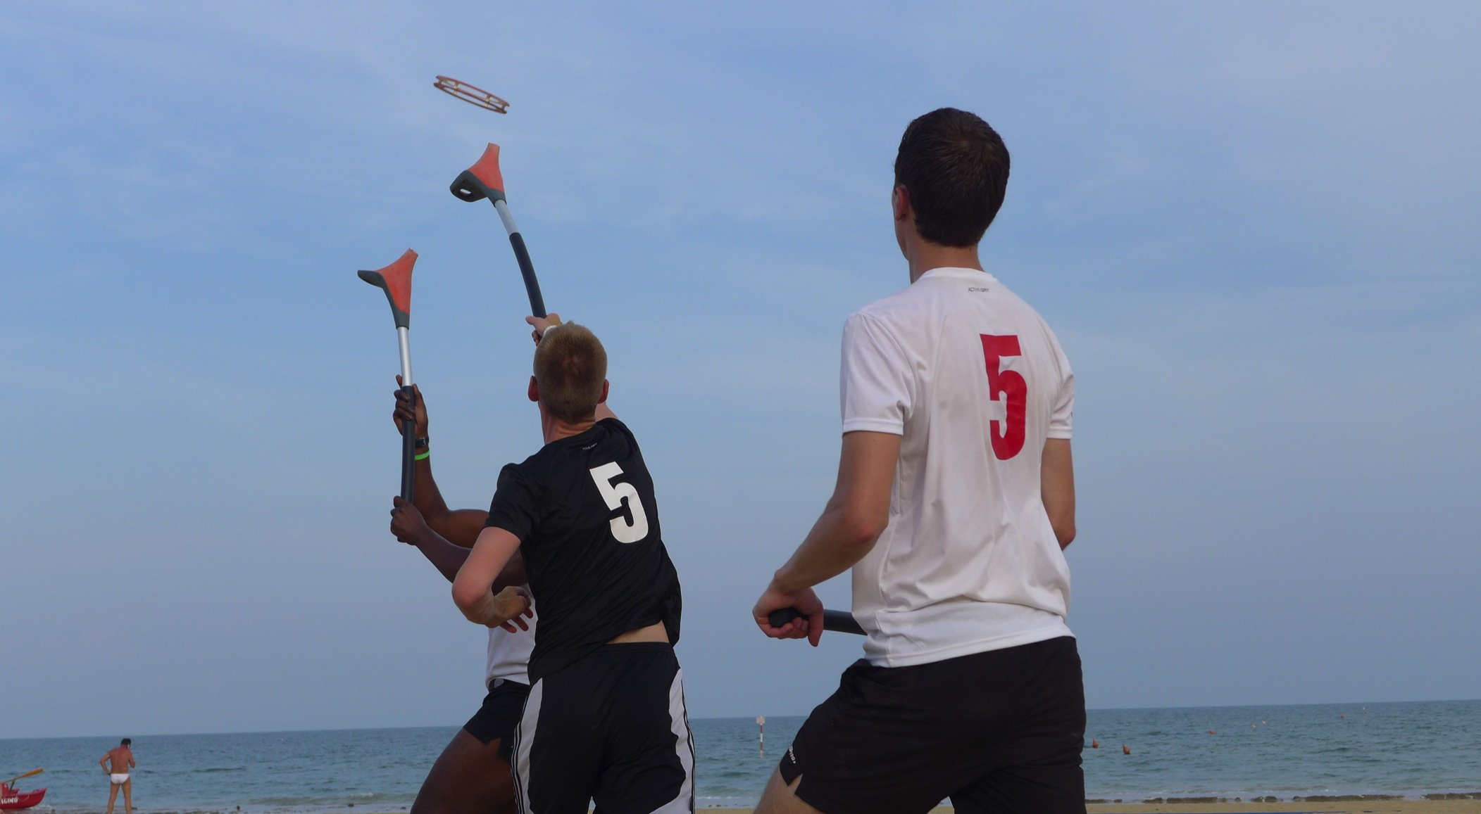

Slide 12
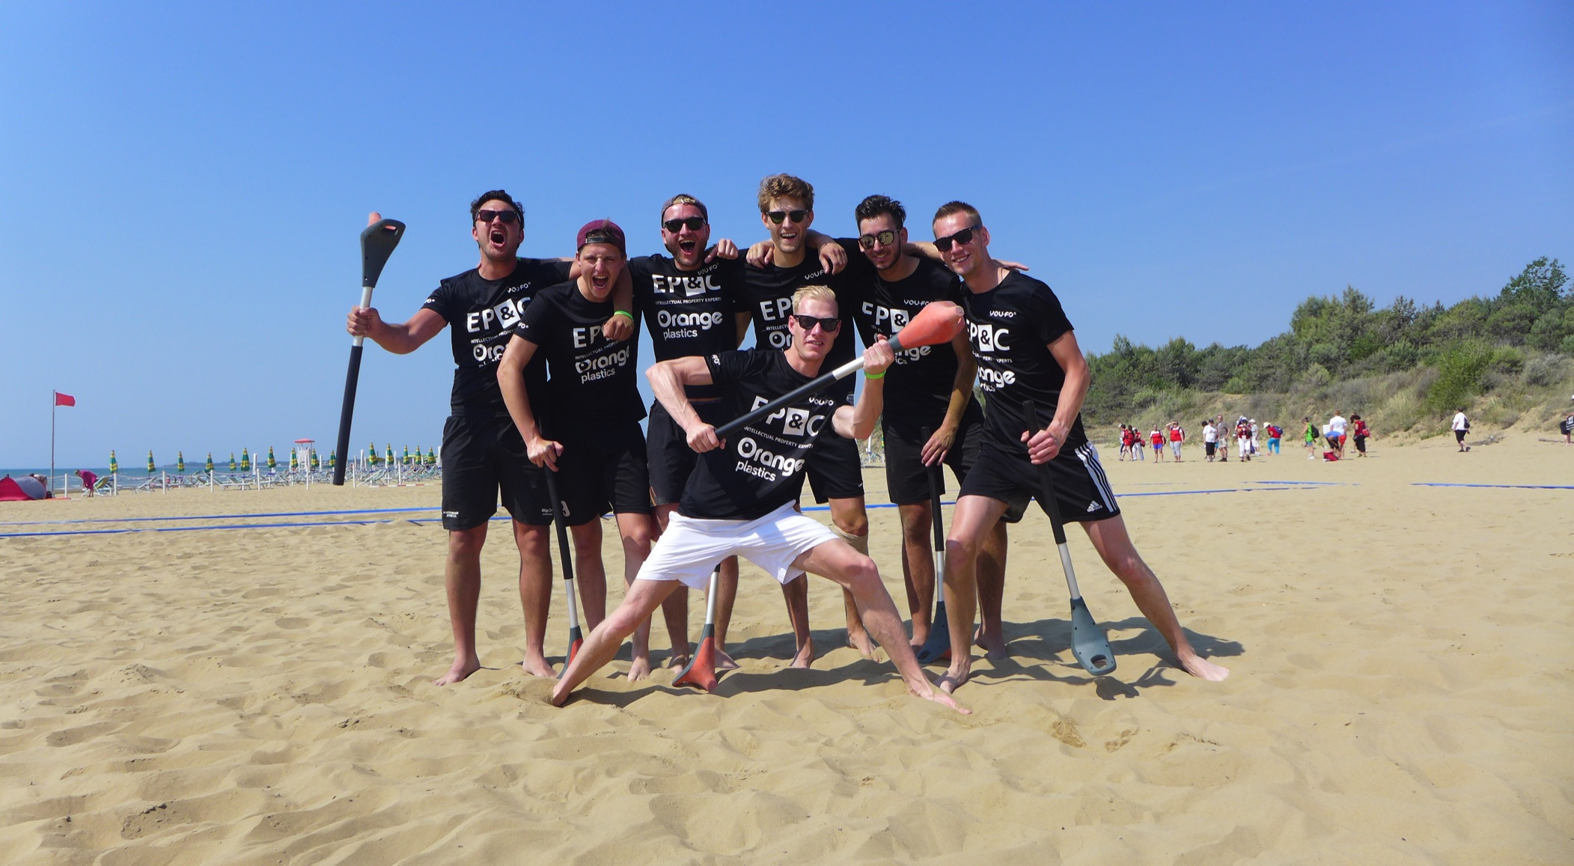

Slide 13
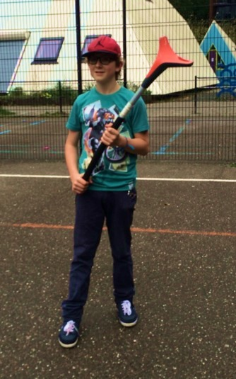
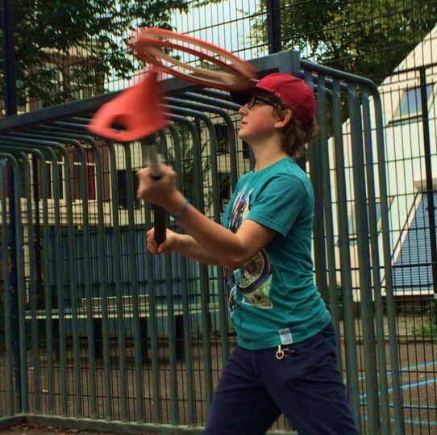
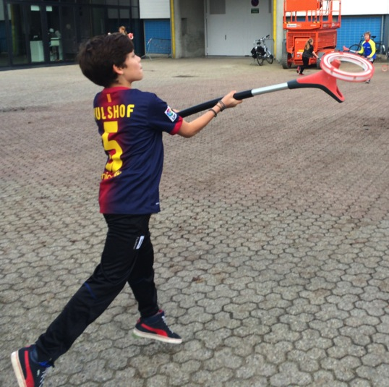
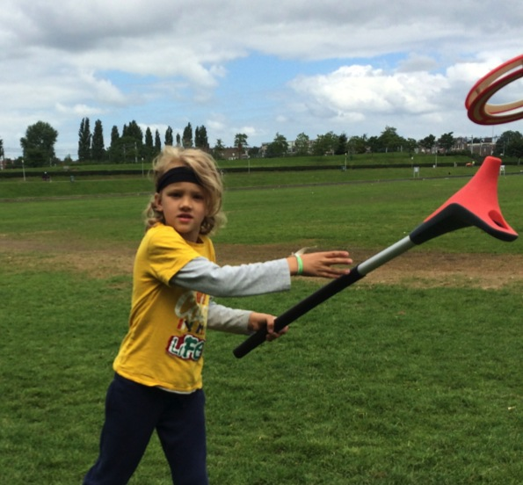
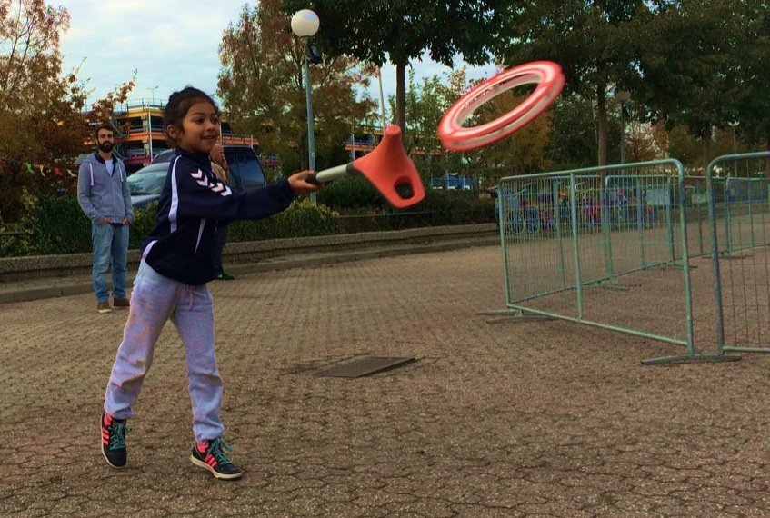

Slide 14
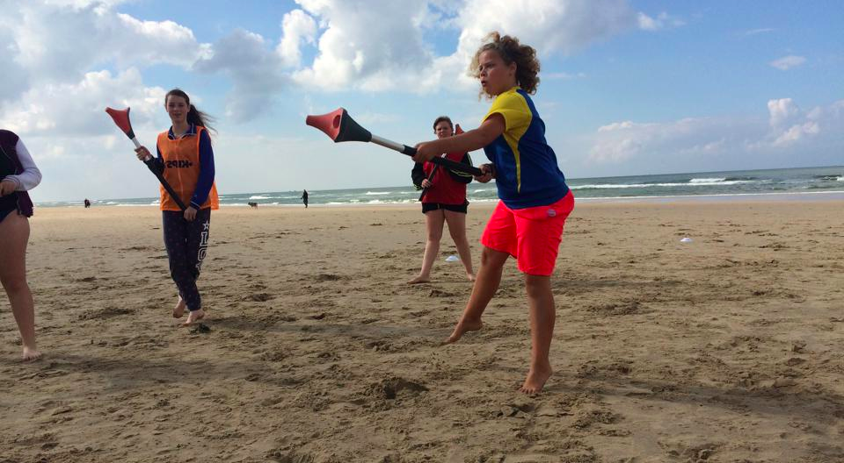

Slide 15
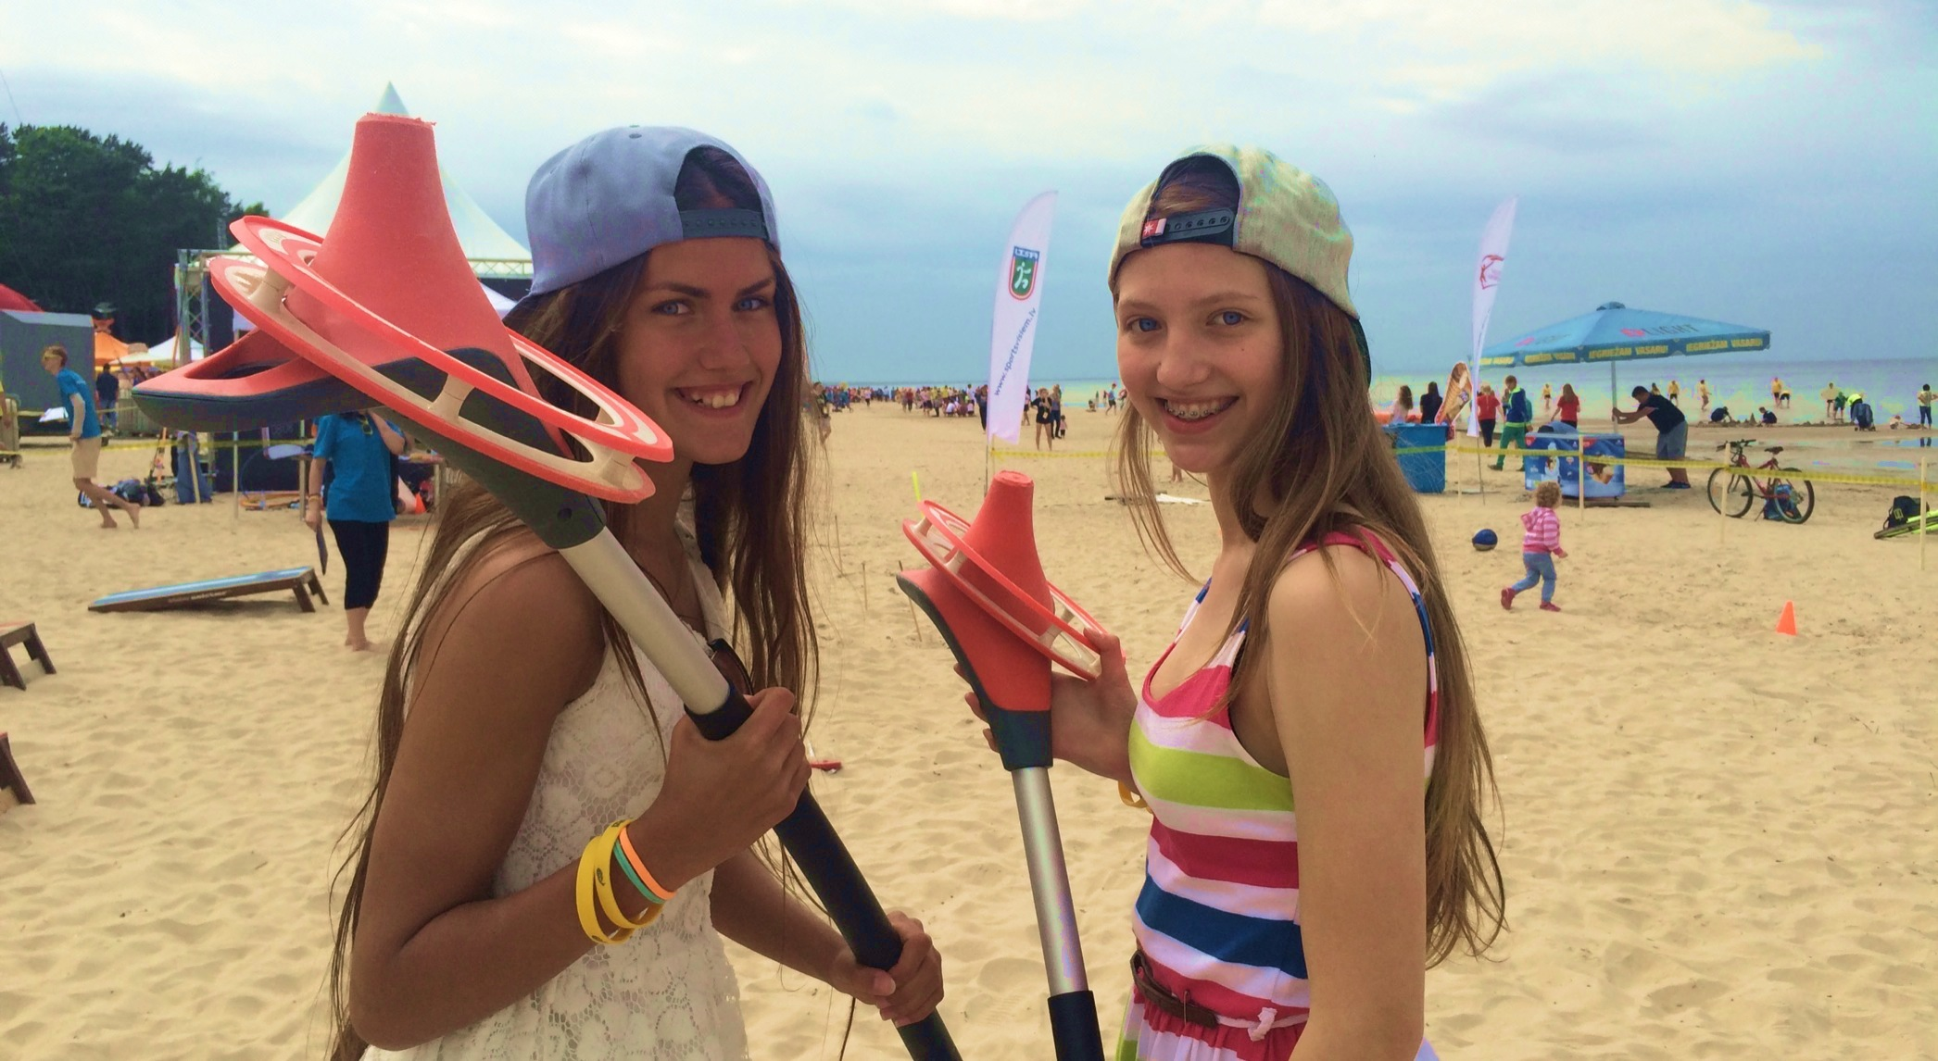

Slide 16
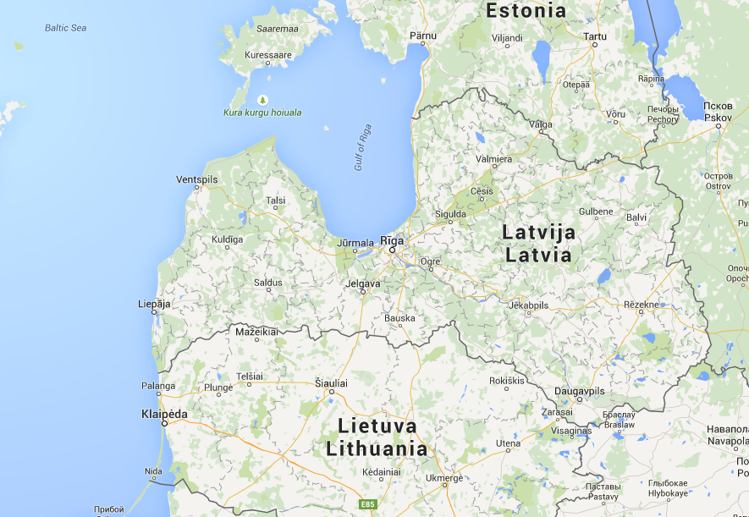

Slide 17
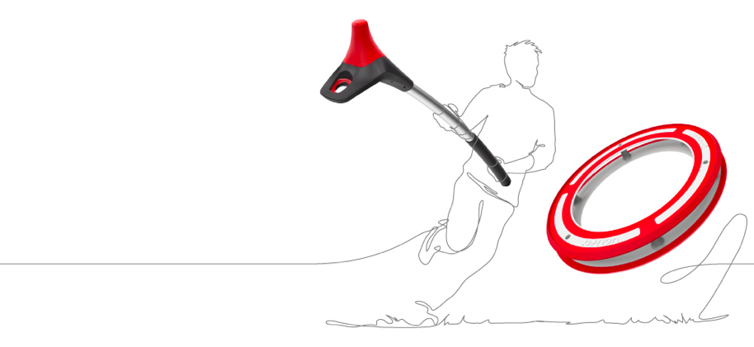
Why is YOU.FO interesting for your local community?
For all (10+)
Many different game concepts
Innovative

Slide 18
Visos vecumos no 10+
Dažādi spēles varianti
Jauna

Slide 19
YOU.FO in Latvia
We invite you to start your own YOU.FO community in Latvia!
All ages 10+
Many different game concepts
Build teams for:
  National competitions
  CSIT World Sport Games 2017 / Riga

Slide 20
YOU.FO Latvijā
Mēs aicinām Jūs uzsākt veidot YOU.FO spēles komandas
Visos vecumos no 10+
Dažādi spēles varianti
Veidot komandas:
      Valsts līmeņa sacensībām
      Pasaules strādājošo un amatieru sporta spēlēm Rīgā 2017. gadā.

Slide 21
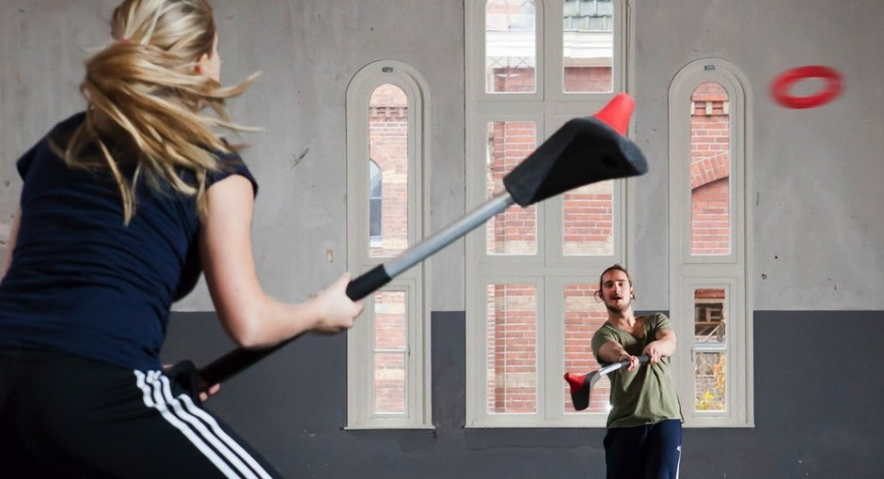
“Incredibly innovative, with a good mix between power and balance”
- Jury Profit Eindhoven.

Slide 22
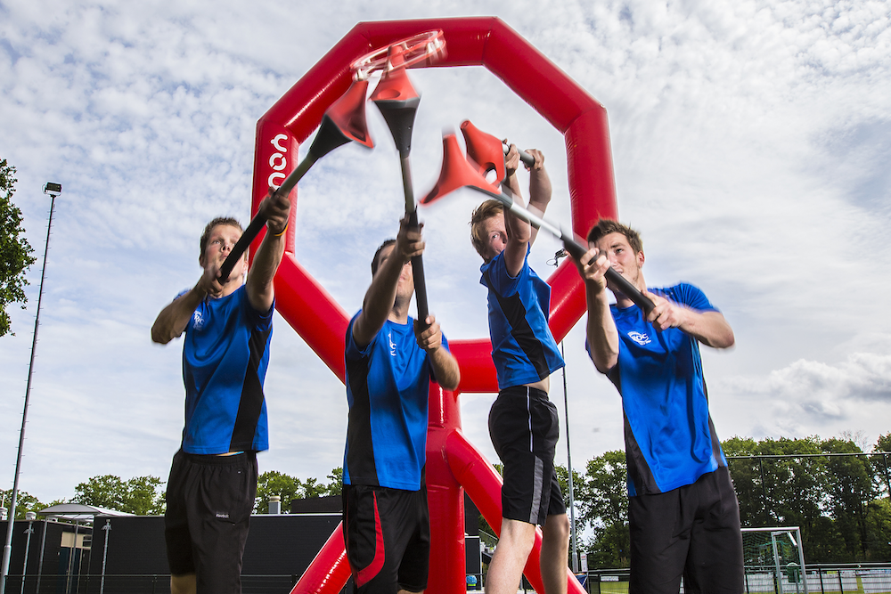
“Great potential for sports participation world wide”
- partner NOC*NSF (Dutch Olympic Committee)

Slide 23
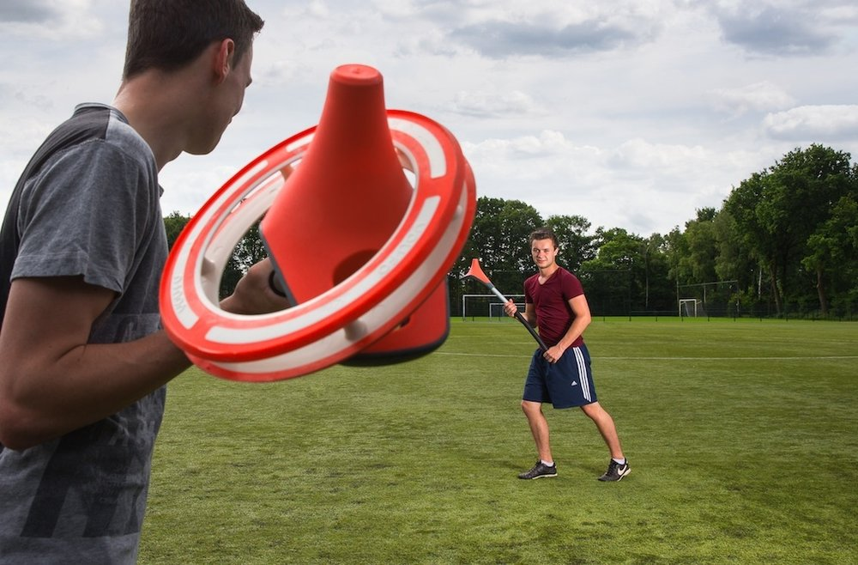
“Fast and fun, you get a big kick when you manage to throw and catch the ring”
(YOU.FO player)

Slide 24

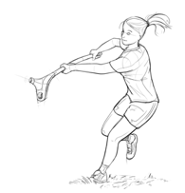
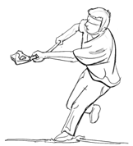
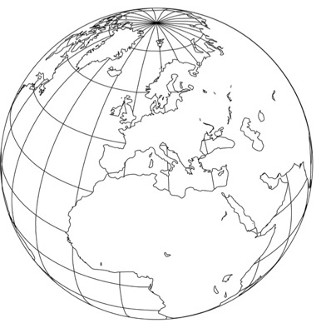
Our goals
to become a globally accepted new sports and leisure game

